Slide 1

UNIT-I: LASER & FIBER OPTICS
Dr.A.Sivakami,
Associate Professor,
Department of Physics,
Malla Reddy University, Hyderabad.

Slide 2
COURSE NAME & COURSE CODE
SUBJECT: APPLIED PHYSICS [AP]
SUBJECT CODE: MR22-1BS0121
CREDITS-3

Slide 3
Syllabus
UNIT-I: Laser
UNIT-II: Fiber Optics
UNIT-III: Quantum Mechanics
UNIT-IV: Band Theory of Solids
UNIT-V: Semiconductor Physics

Slide 4
Unit-I: Laser
LASER: Interaction of light radiation with matter: Absorption, Spontaneous and Stimulated emissions of light, Einstein coefficients, population inversion, Meta stable state, Types of pumping, optical and electrical pumping, three and four level laser schemes, Construction and working of laser: Ruby, Helium-Neon and Semiconductor diode, Applications of lasers in industry, Medical and information Technology.

Slide 5
Laser
LASER stands for Light Amplification by Stimulated Emission of Radiation
Artificial light
Extraordinary properties over other sources like sun & electric bulb, tube light etc.
It is a high technology device and more useful in variety of fields such as communications, medical, industry and weapon guidance in wars.

Slide 6
History of laser

Slide 7
Practical laser invention
T.H Maiman built the first laser device in 1960.

Slide 8
Characteristics or properties of laser
The light emitted from a laser is monochromatic, that is, it is of one color/wavelength. In contrast, ordinary white light is a combination of many colors (or wavelengths) of light.
Lasers emit light that is highly directional, that is, laser light is emitted as a relatively narrow beam in a specific direction. Ordinary light, such as from a light bulb, is emitted in many directions away from the source.

Slide 9
Characteristics or properties of laser
The light from a laser is said to be coherent, which means that the wavelengths of the laser light are in phase in space and time. Ordinary light can be a mixture of many wavelengths.
High Intensity
These four properties of laser light are what can make it more hazardous than ordinary light. Laser light can deposit a lot of energy within a small area.

Slide 10
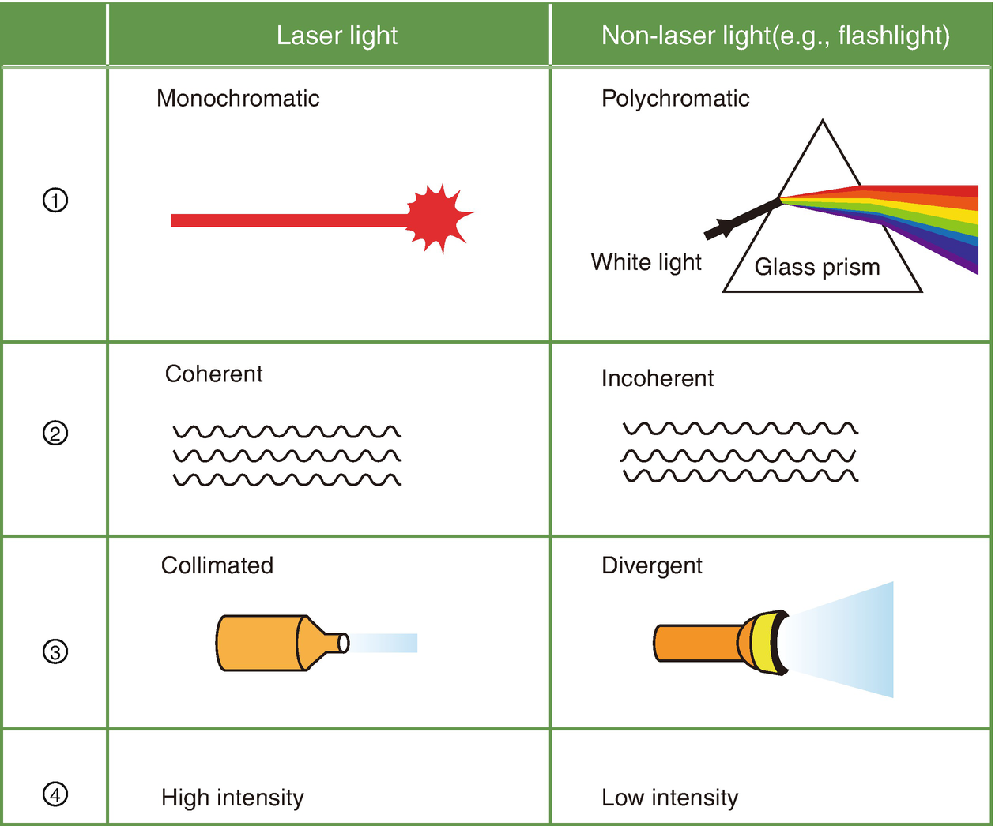

Slide 11
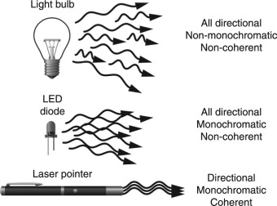

Slide 12
Interaction of light with matter
Matter is composed of atoms, ions or molecules and it is through their interactions with light which gives rise to the various phenomena which can help us understand the nature of matter
Transfer of energy from atom to light cannot be explained in the classical point of view. Possible explanation from quantum theory of radiation
The transfer of energy from atom to light results in light amplification.

Slide 13
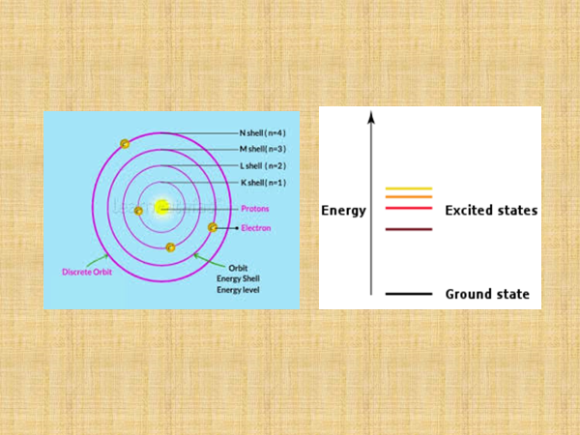

Slide 16
Absorption process of light: process in which transition takes from ground state (low energy state) to excited state (high energy state) by absorbing the external energy in the form of light or temperature

Slide 19
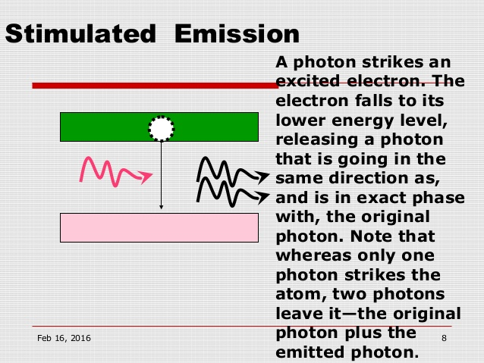

Slide 20
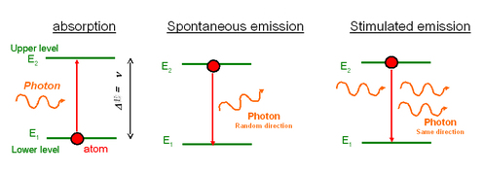
All Processes

Slide 21
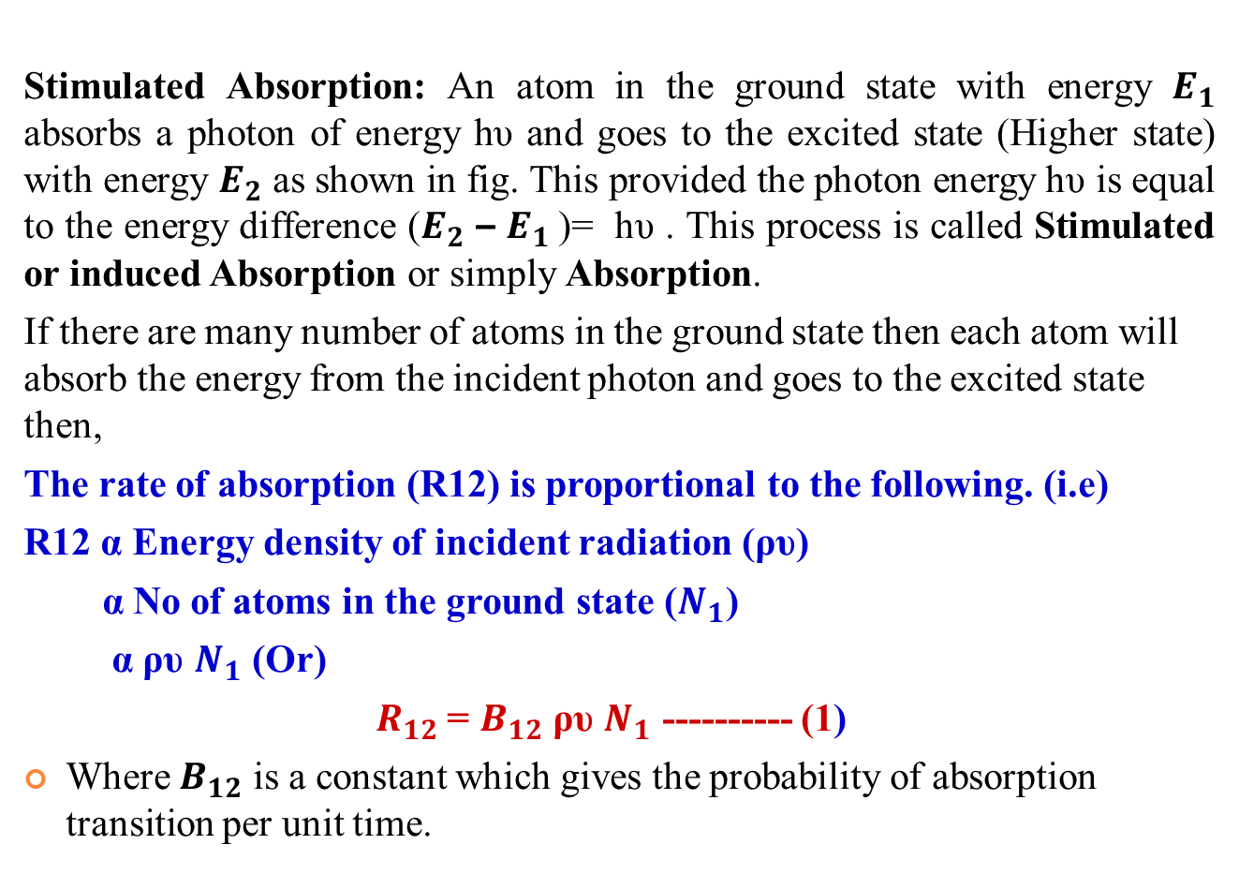
Einstein Coefficients derivation (a & b) (Upward Transition)

Slide 22
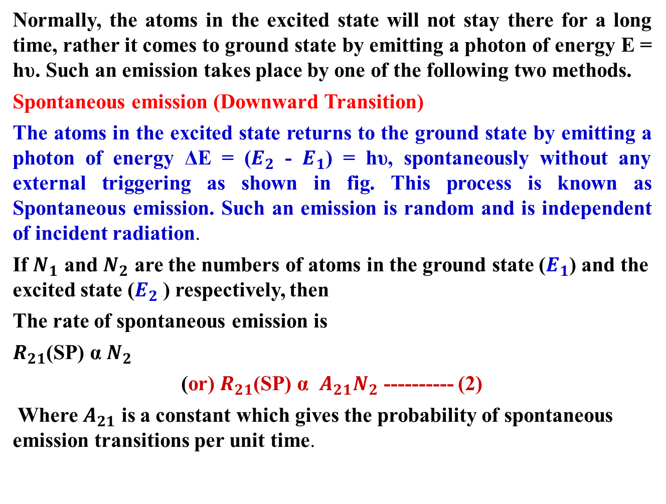

Slide 23
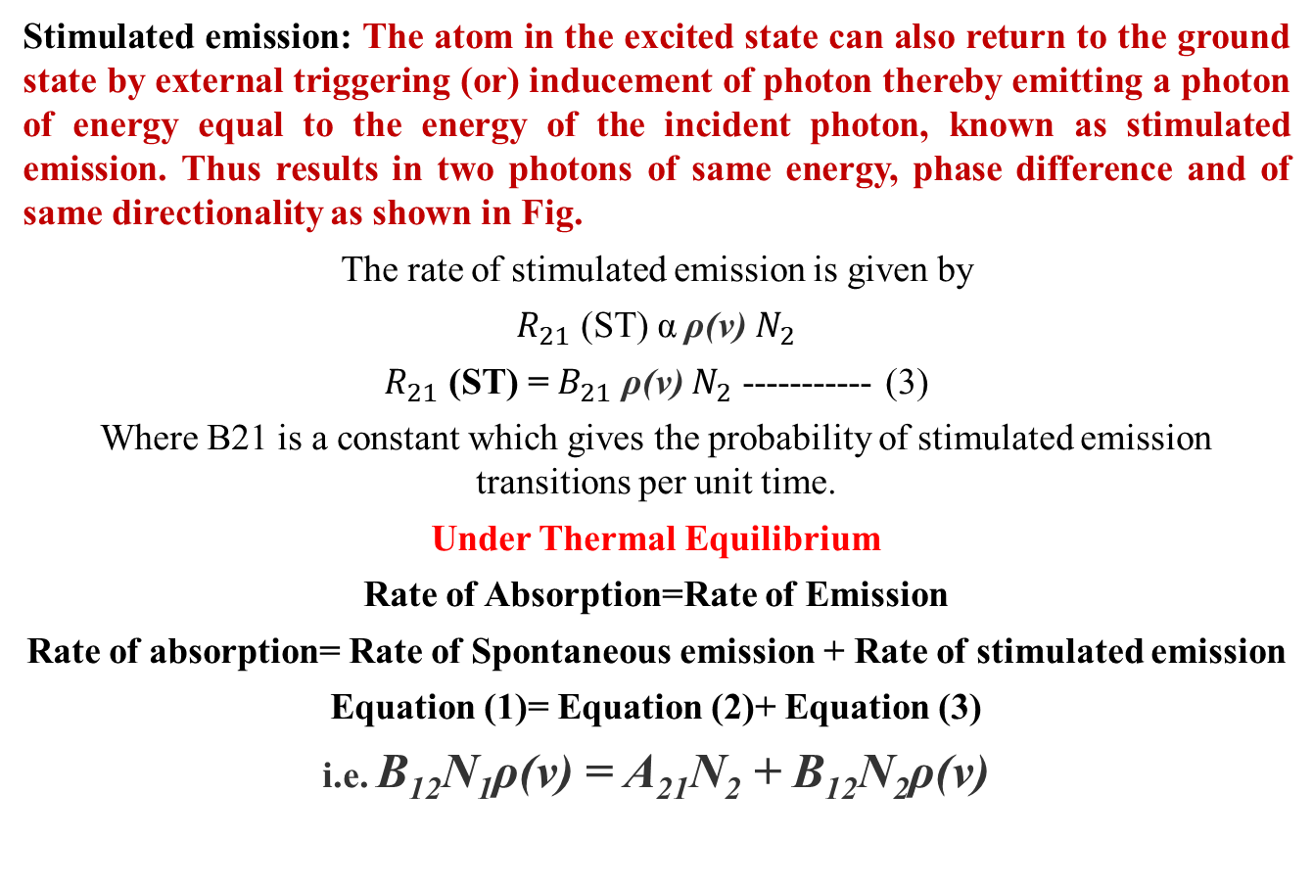
Stimulated emission (Downward Transition) & Einstein theory

Slide 24
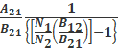
B₁₂N₁ρ(ν) – B₂₁N₂ρ(ν) = A₂₁N₂
[B₁₂N₁ – B₂₁N₂] ρ(ν) = A₂₁N₂
ρ(ν)= -------(4)

Slide 25

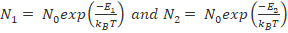
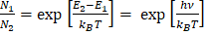
,
But, in thermal equilibrium, the Boltzmann’s distribution law applies, so,
----------(5)
If n=1, n=2 the equation (5) becomes
where, N_{o} is population in ground state and k_{B} is the Boltzmann’s constant.
Therefore
------------(6)
(Since, E₂-E₁= hν)

Slide 26
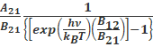
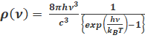
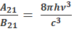
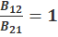
Substituting equation (6) in equation (4) becomes
ρ(υ)=
ρ(ν)= ------------(7)
According to Plank’s law of black body radiation at temperature T we have the energy density ρ(ν) at frequency ν is
-----------(8)
Comparing equations (7) & (8)
-------------(9)
------------(10)
Equations (9) and (10) show the relations between Einstein’s coefficients B₁₂, B₂₁ and A₂₁.
From the above relation eq. (9) shows that the ratio of rate of spontaneous (A₂₁) to rate of stimulated emission (B₂₁) is proportional to cube of the frequency of the incident radiation. (We cannot use high frequency radiation such as x rays for laser production)The eq. (10) shows that the rate of absorption is equal to the rate of stimulated emission, when the system in equilibrium.

Slide 27
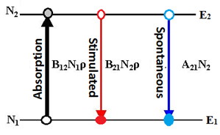
Conditions for light amplification
1) Stimulated emission to dominate spontaneous emission
Stimulated emission/spontaneous emission= equation =B21N2ρ(v)/A21N2=B21/A21 x ρ(v)
2) Requirements of excited states of larger lifetimes-Meta stable state
3) Stimulated emission to dominate the stimulated absorption
Stimulated emission/stimulated absorption=
B21N2ρ(v)/ B12N1ρ(v)=B21/B12 x N2/N1

Slide 28
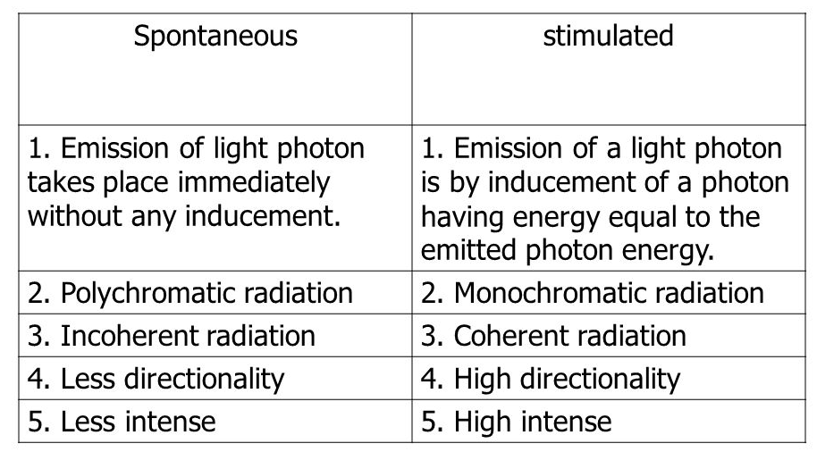
Difference between spontaneous emission & stimulated Emission

Slide 29
Three requirements for laser action
POPULATION INVERSION
METASTABLE STATE
EXPERIMENTAL SET UP FOR CONFINING THE RADIATION WITHIN A MEDIUM- HIGH ENERGETIC LASER BEAM as OUTPUT-OPTICAL RESONATOR

Slide 30
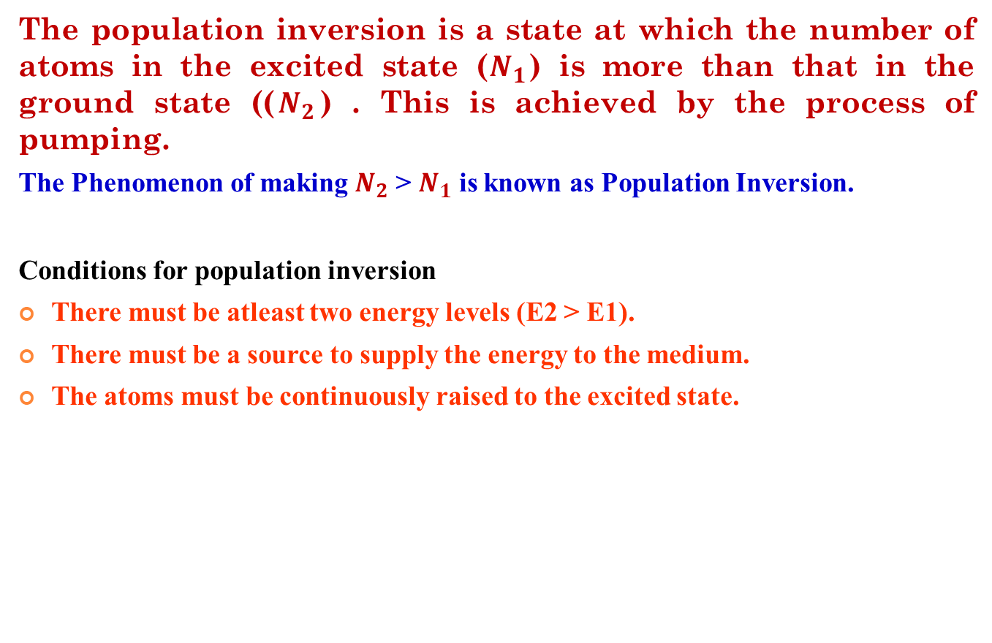
Population inversion

Slide 31
Metastable state
Definition: It is a excited state of an atom or other system with a longer life time than other excited states. There could be no population inversion and hence no laser action, if metastable state not exist.
In order to do so, the excited atoms are required to ‘wait’ at the upper energy level till a large number of atoms accumulate at that level. In other words, it is necessary that excited state have a longer lifetime. A Meta stable state is such a state

Slide 32
Metastable state

Slide 33
Confining the radiation within medium-Optical Resonator
The stimulated emission should be dominated than spontaneous emission.
For maintain this, there is a need to fabricate new set up is called as OPTICAL RESONATOR.

Slide 34
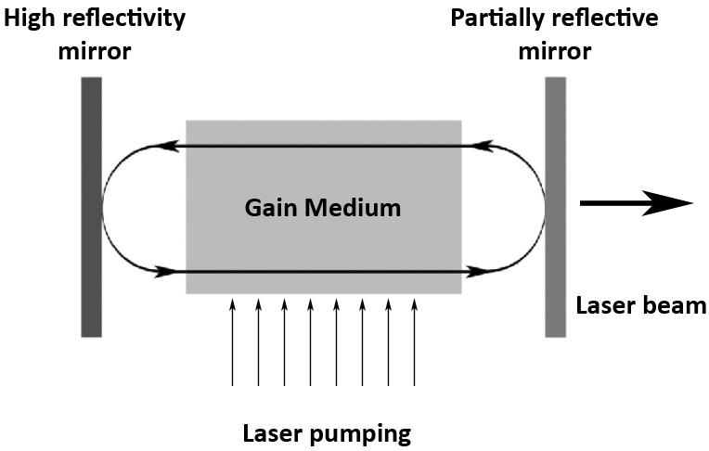
Optical Resonator

Slide 35
THREE Principal Components of laser
1.Active medium: To maintain the Population inversion in a material medium for laser action
2. Pumping: To achieve the condition for population inversion
3. Optical resonator: Helps to amplify the light inside the active medium and finally emits high intensity laser light.

Slide 36
THREE Principal Components of laser

Slide 37
1.Active Medium
Definition:
A medium in which population inversion can be achieved is known as active medium.
Active Center: The material in which the atoms are raised to the excited state to achieve Population Inversion is called Active Center.
2.PUMPING
Definition: The process to achieve the population inversion in the medium is called pumping action. It is essential requirement for producing laser beam. It is an external source that supplies energy to laser medium.

Slide 38
.
PUMPING METHODS
The most commonly used pumping methods are
Optical pumping
Electrical discharge
Direct Conversion
Inelastic atom –atom collision between atoms

Slide 39
(i) Optical Pumping-Light Source
When the atoms are exposed to light radiations energy hv, atoms in the lower energy state absorb these radiations and they go to the excited state. This method is called Optical pumping. It is used in solid state lasers like ruby laser and Nd-YAG laser. In ruby laser, xenon flash lamp is used as pumping source.

Slide 40
(ii)Electrical Discharge method-Discharge tube as Tube light
In this method, the electrons are produced in an electrical discharge tube. These electrons are accelerated to high velocities by a strong electrical field. These accelerated electrons collide with the gas atoms.
By the process, energy from the electrons is transferred to gas atoms. Some atoms gain energy and they go to the excited state. This results in population inversion. This method is called Electrical discharge method.
It is represented by the equation, A + e* = A* + e
Where A – gas atom in the ground state
A* = same gas atom in the excited state e* = Electrons with higher Kinetic energy e – Same electron with lesser energy.
This method of pumping is used in gas lasers like argon and CO2 Laser.

Slide 41
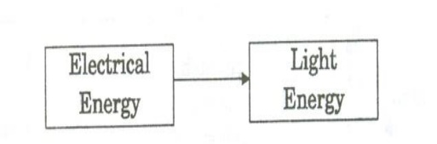
(iii)Direct Conversion
In this method, due to electrical energy applied in direct band gap semiconductor like GaAs, recombination of electrons and holes takes place. During the recombination process, the electrical energy is directly is converted into light energy.

Slide 42
(iv)In elastic atom-atom collision
In this method, a combination of two gases (Say A and B are used). The excited states of A and B nearly coincides in energy.
In the first step during the electrical discharge atoms of gas A are excited to their higher energy state A* (metastable state) due to collision with the electrons.
A + e* = A* + e
Now A* atoms at higher energy state collide with B atoms in the lower state. Due to inelastic atom - atom collision B atoms gain energy and they are excited to a higher state B* . Hence, A atoms lose energy and return to lower state.
A* + B = A + B*
It occurs in He-Ne Laser

Slide 43
3.Optical resonator
An optical resonator consists of a pair of reflecting surfaces in which one is fully reflecting (R1) and the other is partially reflecting (R2). The active material is placed in between these two reflecting surfaces.
The photons generated due to transitions between the energy states of active material are bounced back and forth between two reflecting surfaces.
This will induce more and more stimulated transition leading to laser action.

Slide 44
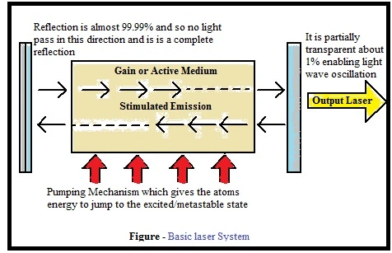
3.Optical resonator

Slide 45
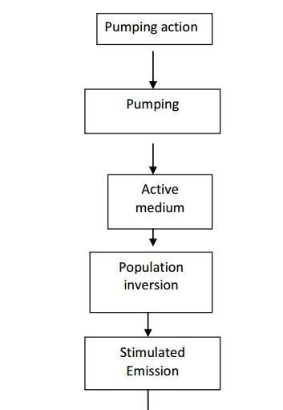
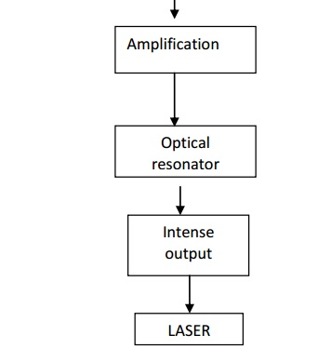
Flowchart for laser action

Slide 47
THANK YOU

